Slide 1


Lecture#2
KDD / Data Mining Process
Data
Data
Data
Mining

Slide 2
The Primary Tasks of Data Mining
Classification
  :- learning a function that maps (classifies) a data item into one of several predefined classes.
EX. A classified data of sports car prospect customers
No | income | career | age | Class
1 | .. | .. | .. | Hot customer
2 | .. | .. | .. | Cold customer
3 | .. | .. | .. | Hot customer
4 | .. | .. | .. | Warm customer

Slide 3
Regression / Prediction
  :- learning a function which maps a data item to a real-valued prediction variable.
EX. A prediction model of car accident probability
No | Vehicle speed (mph) | Alcohol level | age | Probability of Car Accident
1 | 80 | 0.02 | 20 | 0.80
2 | 70 | 0.01 | 25 | 0.70
3 | 55 | 0.0 | 30 | 0.05
4 | 60 | 0.1 | 45 | 0.26

Slide 4
Exploration / Description of data
  :- try to describe characteristics of data
  Clustering
    identify a finite set of clusters to describe the data
  EX. A simple clustering data set of loan customers
+ + + + +
+ + + +
Debt
+ +
+ + + +
+ + + +
+ + + +
+ + + +
Income

Slide 5
  Summarization
    :- find a compact description for a subset of data
      Mean of all attributes
      Standard deviation of all attributes
      Summary rules
      Multivariate visualization techniques
      Functional relationships between
      variables

Slide 6
  Dependency modeling
    :- find a model which describes significant dependencies between variables
      structural level
      :- often in graphical form that shows variables are locally dependent on each other
      quantitative level
  Change and deviation detection

Slide 7
KDD / Data Mining Process
Set Goal Mine Measure Deploy
Identify
Business
Problem
Identify
Business
Problem
Select
Target
Data sets
Preprocess
&
Transform Data
Mine Data
Interpret
&
Evaluate
Deploy /
Act on
Knowledge

Slide 8
1. Identify business problem
Goal : To set the goal of the application and to find relevant prior knowledge
    - Prior knowledge are :
      understanding of table
      understanding of attributes
      understanding of the value range in the domain of each attribute

Slide 9
- Examples of business problem
  Marketing & Sales
    customer & product profiles
    predict customer loyalty and retention/attrition/churn
    evaluate the effectiveness of sales campaigns, direct marketing, or mailing responses
    point of sales (POS)

Slide 10
    shelf space allocation
    store layout
    promotion effectiveness
  Finance
    predict a portfolio’s return on investment
    find credit rating of a customer
    detect money laundering
    identify fraud transaction
    i.e.. credit cards, insurance

Slide 11
  Control and scheduling of production
    find optimal quality parameters in a production from initial process control parameters
  Scientific problems
    Bioinformatics
      Deoxyribonucleic acid (DNA)
      Amino acids
      Proteins
      Microarray and gene expression

Slide 12
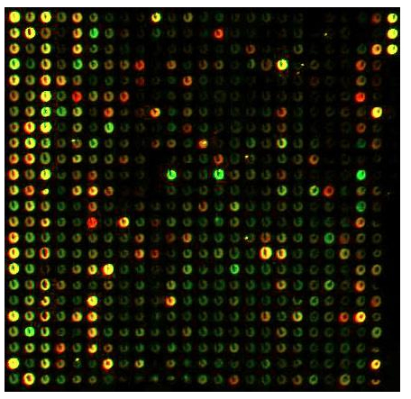
    Ex. A microarray image (Gene Chip)
    Sky survey map
    Biometrics (i.e. retina, fingerprint, palmprint, …etc.)
    Medical data (i.e. MRI, EKG, …etc.)
Image source:
www.gene-chips.com/sample1.html
Note:
The color and intensity of each spot
correspond to a specific gene in the test
sample.

Slide 13
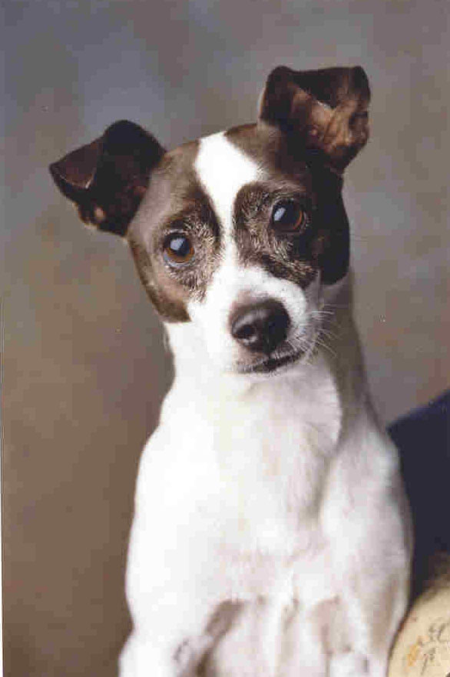
  Identify & understanding of dynamic behavior
    identify of faults in telecommunications
    network
    customer interaction with a web-site
    audio mining in telephone calls
    image mining
    - image mining in VDO scene
    - content-based image retrieval
    Ex “find the image similar to .“

Slide 14
    text mining
    - text mining in e-mail collections
      distilling the meaning of text
      accurate summarization of texts
      subject-focused text exploration
      efficient navigation through a text base
      explication of the text theme structure
      clustering of texts
      semantic information retrieval

Slide 15
  Web mining & e-CRM
    Unobtrusively learn the interests of Web site visitors based on their interaction with the Web site. User profiles are modified in real time as more information is learned.
    Automatically match the best available resource to the interests of the visitor. This capability allows the site owner to target banner ads, suggest related links, or provide dynamic, personalized content.

Slide 16
    Perform real-time response prediction: “Is this visitor going to make a purchase?”
    Perform real-time prospect valuation: “How much is this visitor going to spend?”
    Predict when a visitor is about to leave a site and provide incentives to stay.
    Identify and act on cross-sell and up-sell opportunities.

Slide 17
    Reveal clickstream patterns: “What paths do most users follow?” and “What paths do the most valuable users follow?”
    Increase overall user satisfaction with the Web site.
    Record all customer interactions through the Web site in the most efficient manner.
    Transform and store data on customers in a format suitable for further analysis.

Slide 18
    Use data for learning customer interests, preferences, and possible courses of action.
    Analyze the efficiency of Web site resource and architecture.
    Generate reports for executive managers.
    Recognize repetitive customers and access their profiles.
    Use all harvested knowledge to personalize communications with each customer.

Slide 19
2. Select Target Data Set (s)
Goal: to focus on a subset of variables using feature ranking and selection techniques.
  Data sources (organizational view)
    Public organizations
      Bioinformatics (BLAST, NIH, MIT, etc…)
      UCI machine learning databases
      Etc.

Slide 20
    Private company
      in-house
      information broker companies / information providers
      credit card companies
      banks
  Data sources ( physical view )
    data warehouse - data marts
    databases - files

Slide 21
  Identify target data set(s)
    Ex1 Marketing campaign for expensive condominiums
    EXPATs
    Thai Executives
    Ex2 Spending pattern of urban consumers
    Bangkok
    Chiangmai
    Ex3 customer profiles of office woman Age 23-35
    Ex4 Gene expression analysis of cancer cells
    A375 or B16 melanoma cells

Slide 22
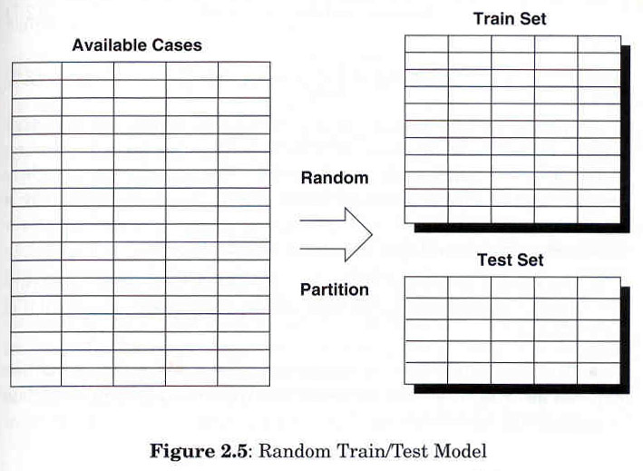
  Identify training and testing data set
Source: Weiss, S., and Indurkhya, N., Predictive data mining: a practical guide

Slide 23
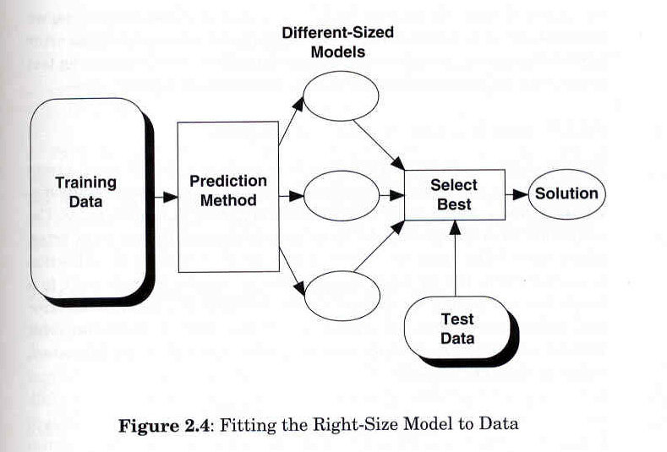
Source: Weiss, S., and Indurkhya, N., Predictive data mining: a practical guide

Slide 24
3. Preprocess & Transform data
Goal: to improve the quality of the actual data for mining and also to improve the mining efficiency.
Data Cleaning
    normalization
    noise/outlier removal
    handling of missing data
    reduction of redundancy

Slide 25
Data Types
    Numerical data: values can be ordered or compared the degrees of difference
    Ex. Integer ( 3, 4, 5,…)
    Real number (160.5, 172.8, …)
    Categorical data : values are expressed as labels, might not be able to be ordered
        Ex. Size (small, medium, large, …)
        Color (white, green, red, …)

Slide 26
Normalization: a method to adjust numerical data into the same range to avoid bias effect in the data mining process
Normalized value (X’) = X - min
max - min
Age
min = 30
max = 60
Ex. Normalization of customer data
Age | Normalized Age | Salary | Normalized Salary
40 | 10/30 = 0.33 | 40,000 | 20,000 / 30,000 = 0.67
60 | 30/30 = 1.0 | 50,000 | 30,000 / 30,000 = 1.0
30 | 0/30 = 0.0 | 20,000 | 0 / 30,000 = 0.0
Salary
min =20,000
max =50,000

Slide 27
  Data integration
    - Integrating multiple, heterogeneous data sets from different sources
  Data reduction and projection
    Finding useful attributes to represent the data
      feature discretization
      feature transformation (i.e. x → log x)

Slide 28
  Ex Feature discretization
Salary
10,000
12,000
35,000
42,000
…
66,000
Salary’
LOW
LOW
MEDIUM
MEDIUM
…
HIGH

Slide 29
4. Mine Data
Goal: search for patterns of interest in a particular data set
  Choose the data mining task
  Choose the data mining algorithm
    association rules
    nearest neighbor
    decision tree

Slide 30

    neural networks
    genetic algorithm
    statistical methods
    other soft computing techniques
      rough sets
      fuzzy logic
      wavelets … etc.
  Mine the data

Slide 31
5. Interpret & Evaluation
  Look for interesting patterns
    Unexpectedness
      :- if the pattern is “surprising” to the user, it potentially delivers new information to the user
    Actionability
      :- when the user can act on the pattern to his/her advantage

Slide 32
  Evaluation and measuring the result
    What is the goal of the data mining exercise?
    How well can the goal be achieved?
    What it is worth to us to achieve the goal?
    [see more details in TEXT Chapter6]

Slide 33
  Measuring classifiers and predictors
    Accuracy
    Goal: The better classifier will yield less classification/prediction error
    Sum of square error (SSE)
n
SSE = ∑ ( t_{i} – O_{i} )²
i = 1
; n = the number of data points in the population
; t_{i} = the actual target value
; O_{i} = the predicted output value

Slide 34
    Mean square error (MSE)
n
MSE = ∑ ( t_{i} – O_{i} )²
i = 1
; n = the number of data points in the population
; t_{i} = the actual target value
; O_{i} = the predicted output value

Slide 35
    Ex Error estimation
No. | Target/True value (t_{i}) | Estimated Output Value(O_{i}) | (t_{i} – O_{i} )²
1 | 10 | 10 | 0
2 | 7 | 5 | 4
3 | 3 | 6 | 9
4 | 15 | 11 | 16
SSE =
29
29
MSE =
Note: the less SSE or MSE, the better

Slide 36
    Lift
    :- the change in concentration of a particular class when the model is used to select a purposefully biased sample from the general population (the higher the better)
Lift = P( class_{t} sample ) / P( class_{t} population)
EX If the mailing population contains 5% responders while the sample contain 50% responders then the lift = 10 (from 50/5)

Slide 37
  Measuring descriptive models
    If two rules cover the same data set, the less complicate rule is considered to have more “expressive power”.
    This is backed up by the minimum description length (MDL) property.
    MDL is the number of bits it takes to encode both the rule and the list of all exceptions to the rule.

Slide 38
6. Deploy / Act on Knowledge
  Ultimate Goal: Turn knowledge into $$$
  Incorporate the knowledge into the performance system.
  Data →Info. →Knowledge → Value

Slide 39
Conclusion
  Virtuous cycle of data mining
    must have a clear goal/value in mind
    interactive and repetitive
    semi-automatic
    [see more details in TEXT Chapter 2, 3]
Virtuous : having or showing virtue [Longman]

Slide 40
References:
Mitra S., and Acharya T., “Data Mining Multimedia, Soft Computing, and Bioinformatics”, John Wiley & Sons, 2003.
Marakas, G., “Modern Data Warehousing, Mining, and Visualization: Core Concepts”, Prentice Hall, 2003.
Berry, M., and Linoff, G., “Data Mining Techniques for Marketing, Sales, and Customer Support”, John Wiley & Sons, 1997.
Fayyad, U., Piatetsky-Shapiro, G., Smyth, P., and Uthurusamy, R., “Advances in Knowledge Discovery And Data Mining”, MIT press, 1996.
Klösgen, W., and Zytkow, J., “Handbook of Data Mining and Knowledge Discovery”, Oxford University Press, 2002.

